Slide 1
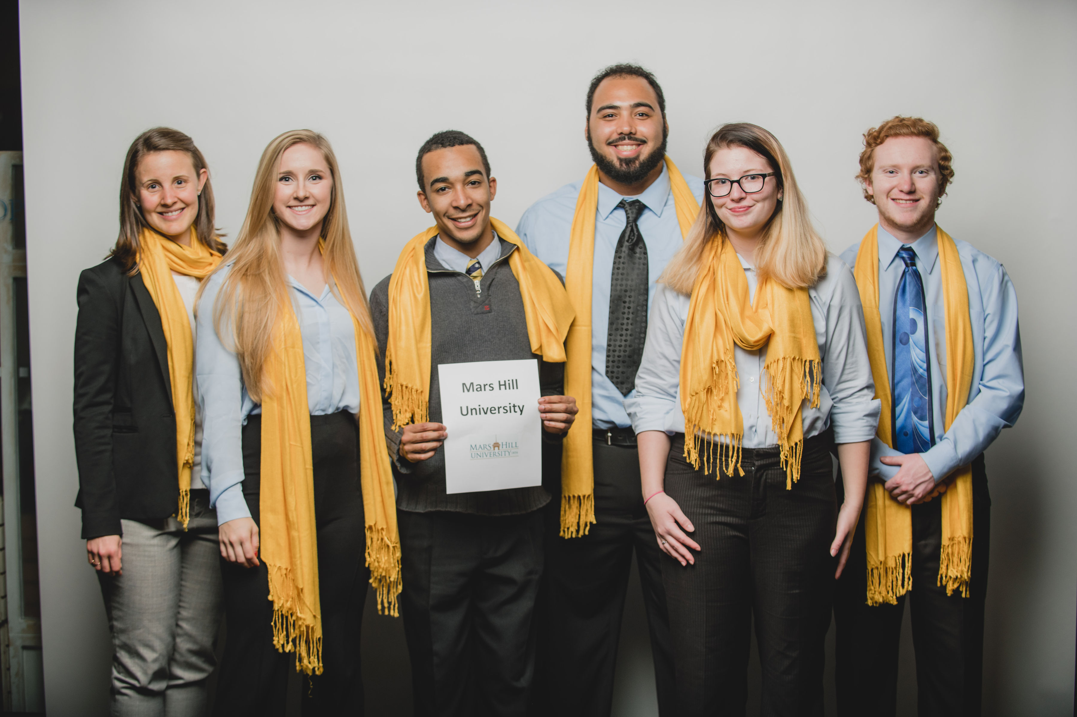
Mars Hill University Ethics Bowl Team 2019

