Slide 1
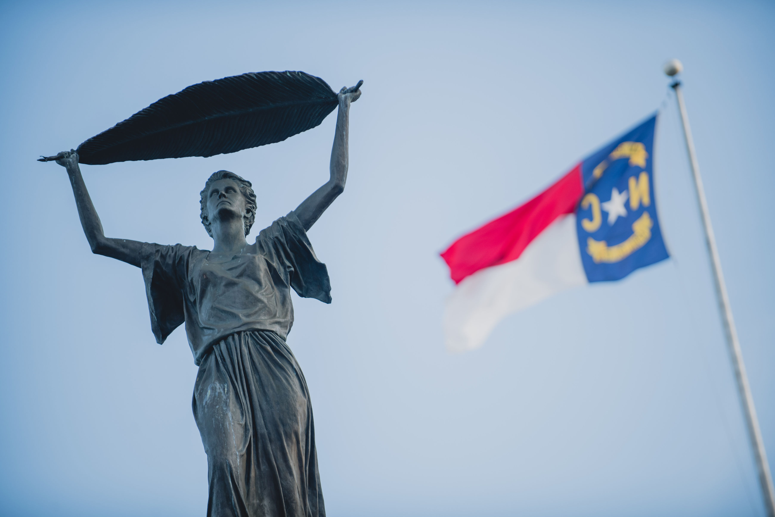
Ethics Bowl 2019

Slide 2
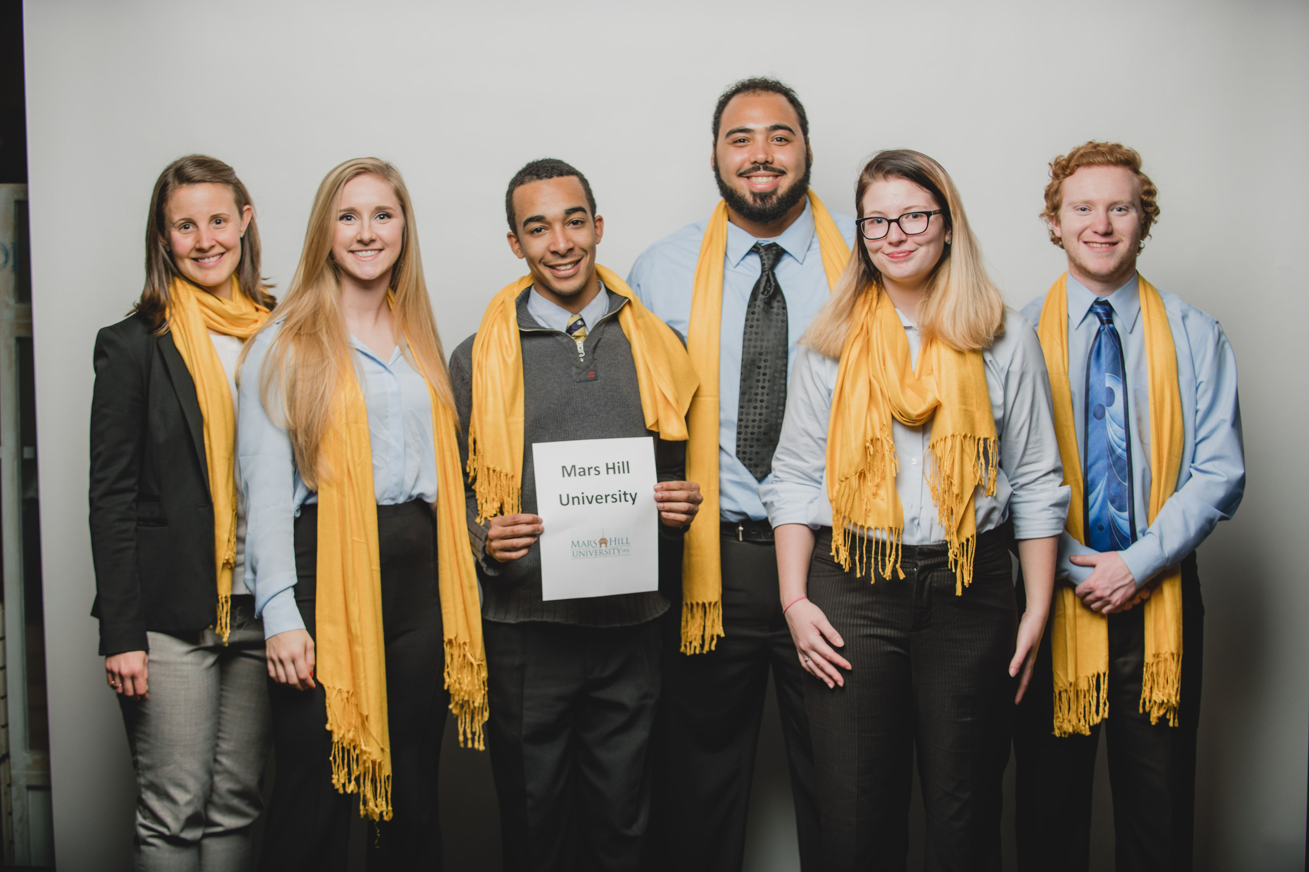
Mars Hill University Ethics Bowl Team 2019

Slide 3
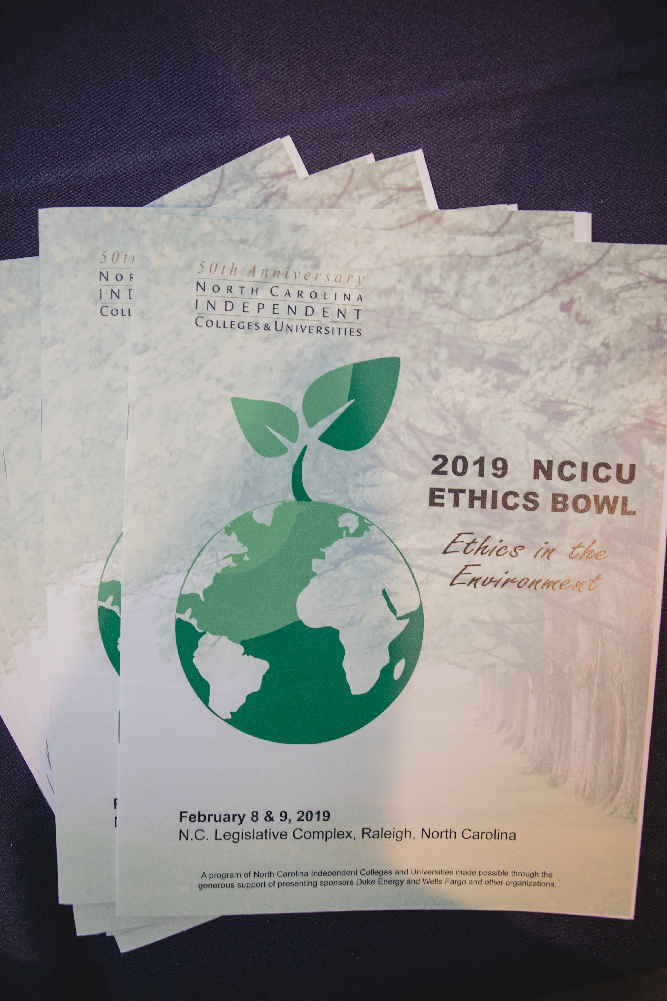
Theme for this year:

Slide 4
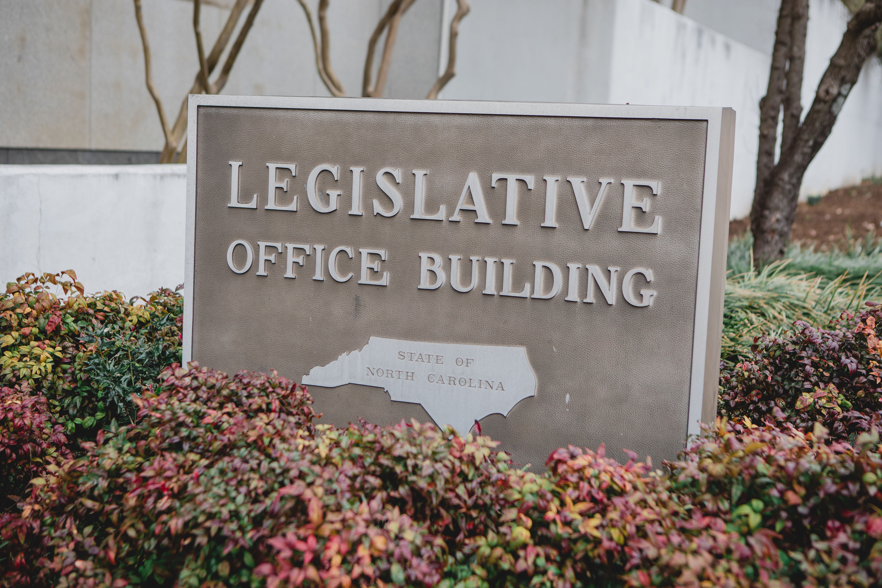

Slide 5
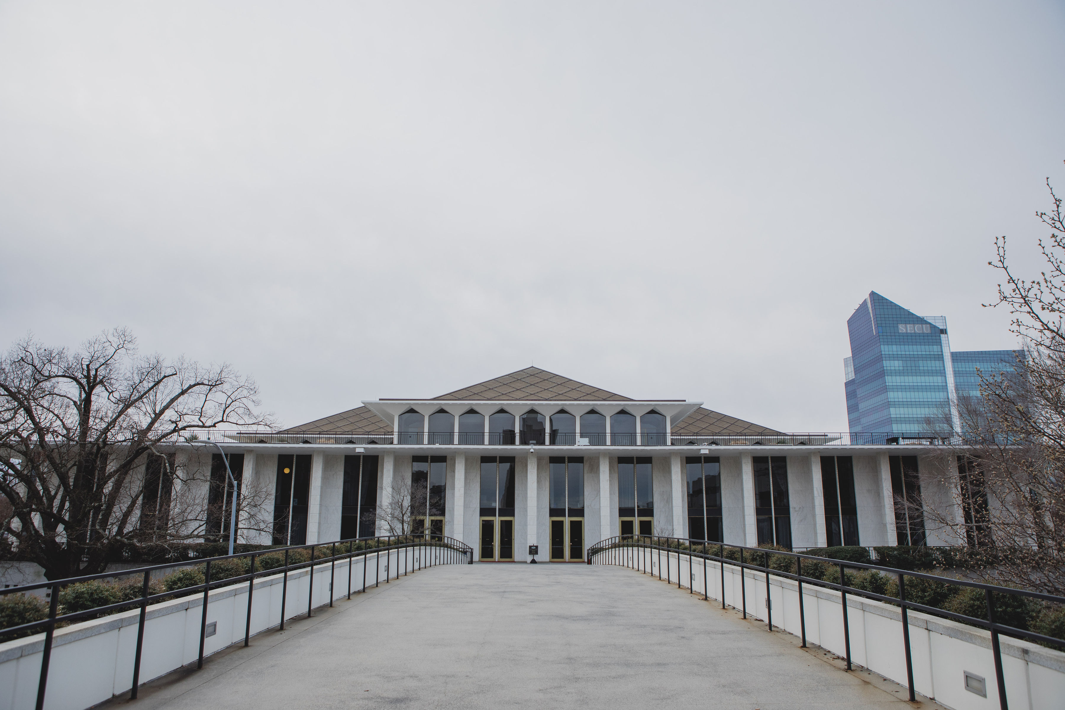

Slide 6
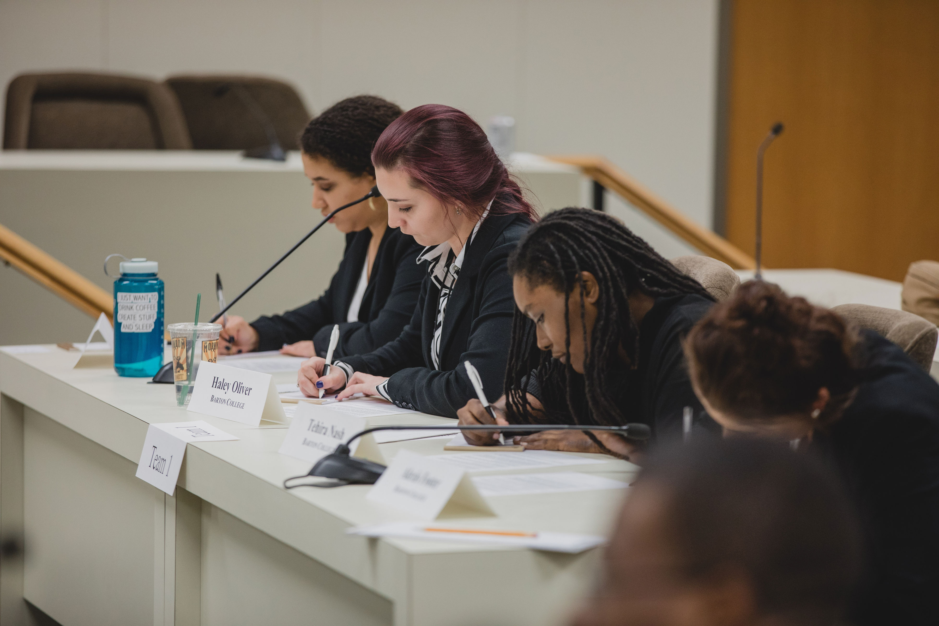
How we Develop a Position:
Read through the entire case and focus on important details
Discuss stakeholders in the case
Discuss the case with a moral framework
Take a position and discuss why

Slide 7
Sunscreen and the Environment

Slide 8
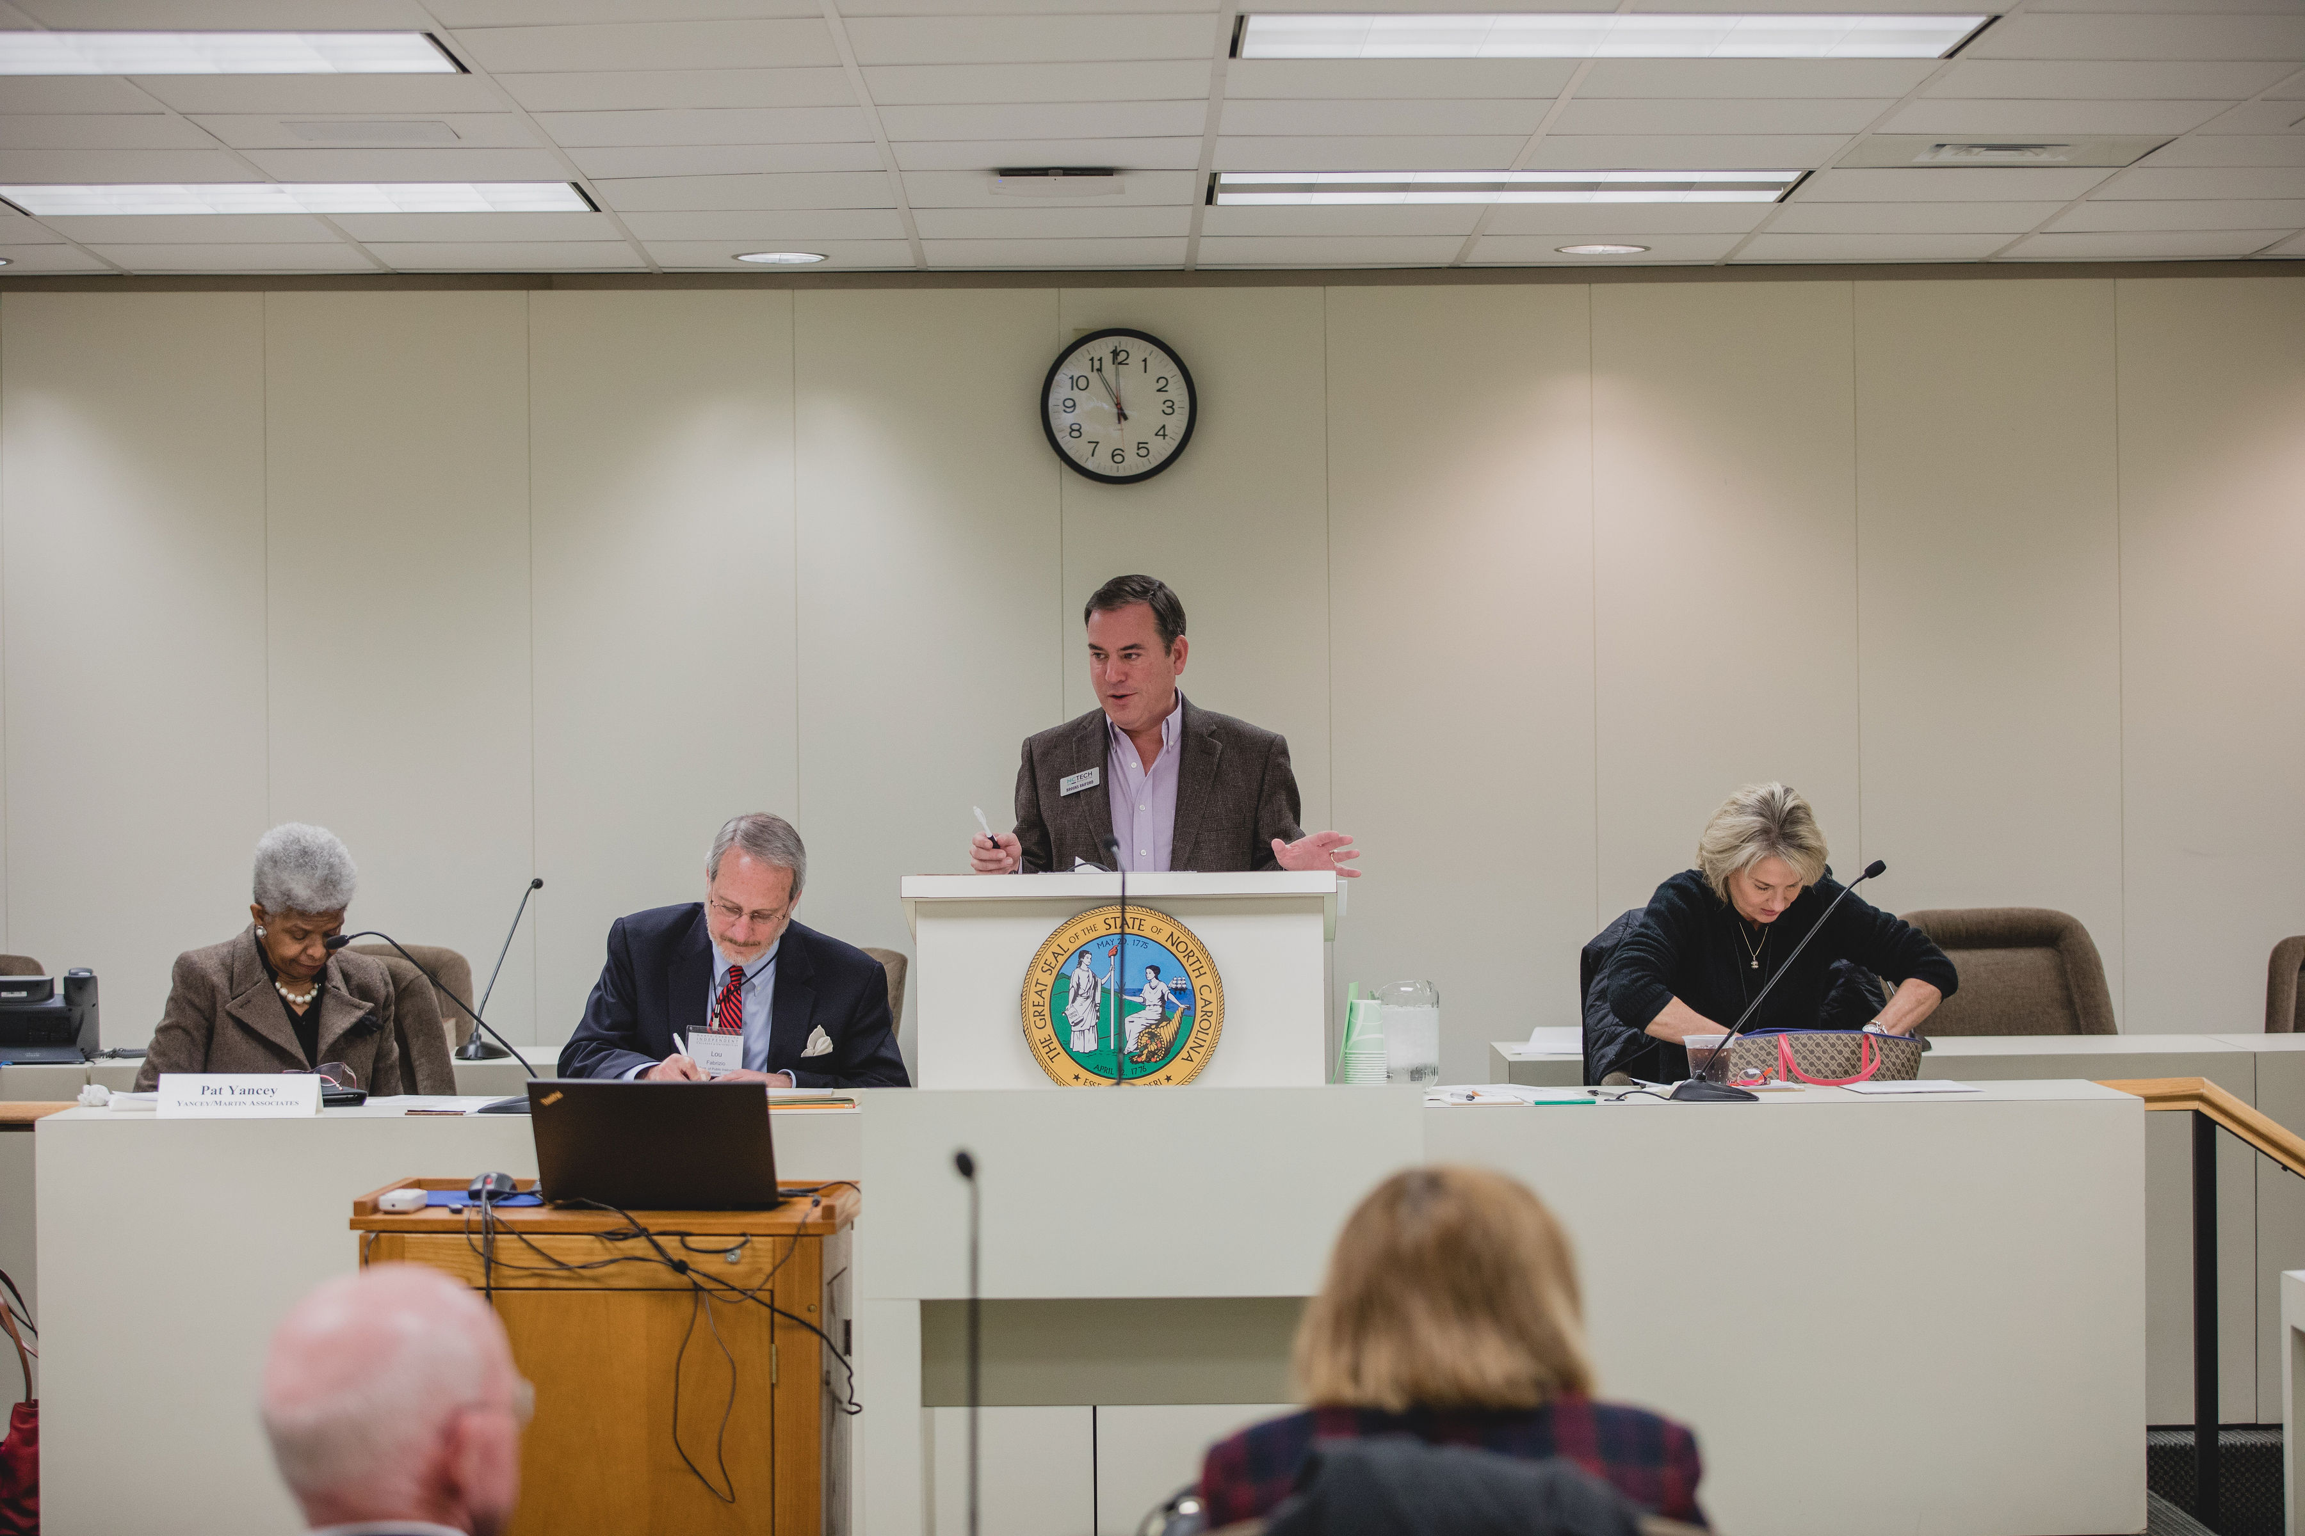
Structure of a Round:
Read the case
5 minutes to develop position with team
3 minutes to present
2 minutes to form a question for the other team
3 minutes to come up with your answer
2 minutes to present your answer
3 minutes to form your closing statement
3 minutes to present your closing statement

Slide 9
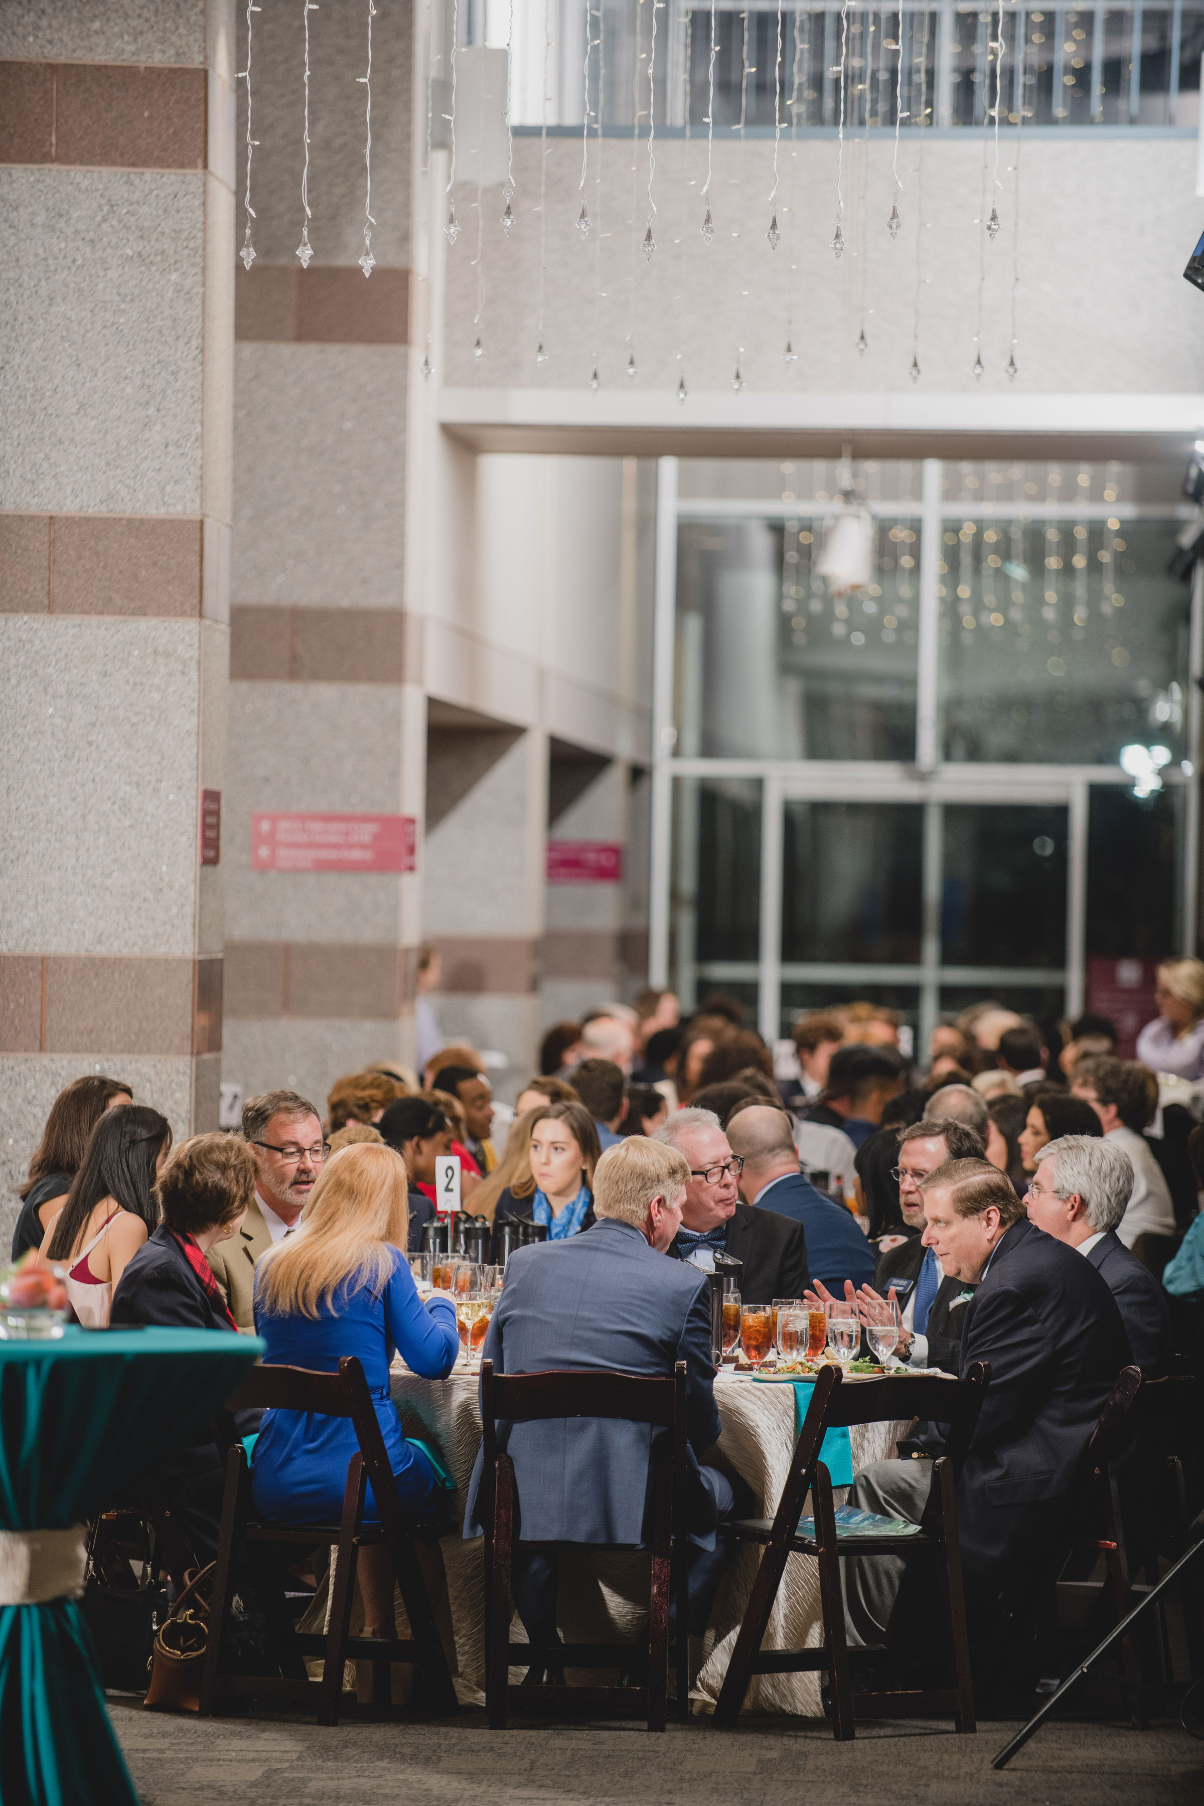
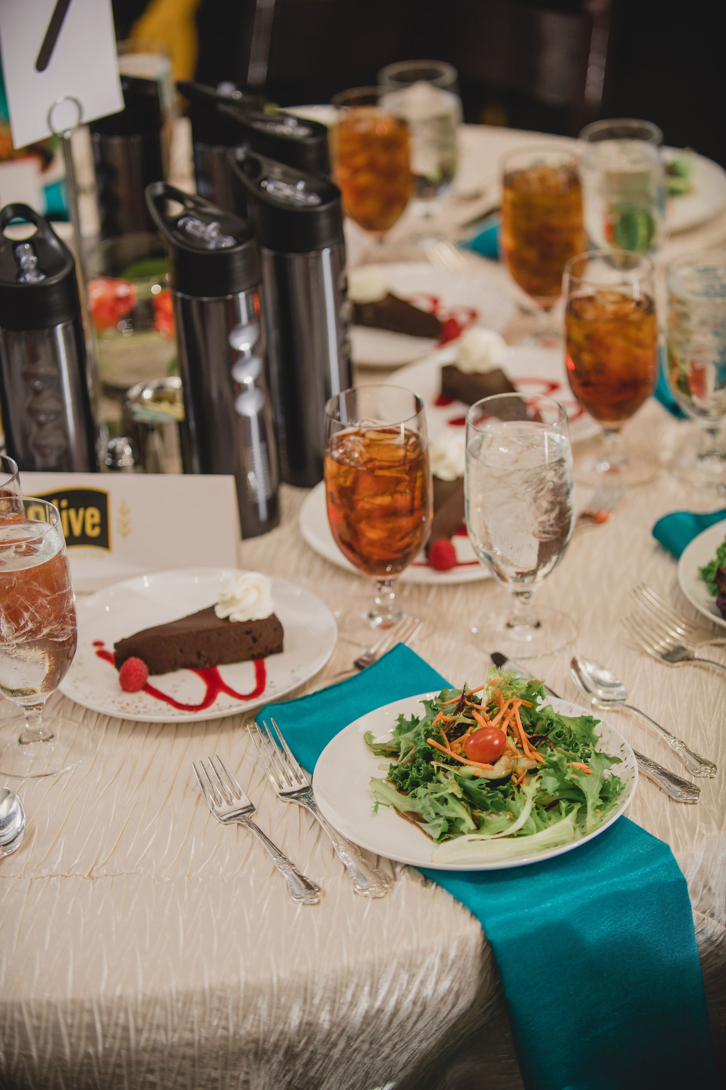

Slide 10
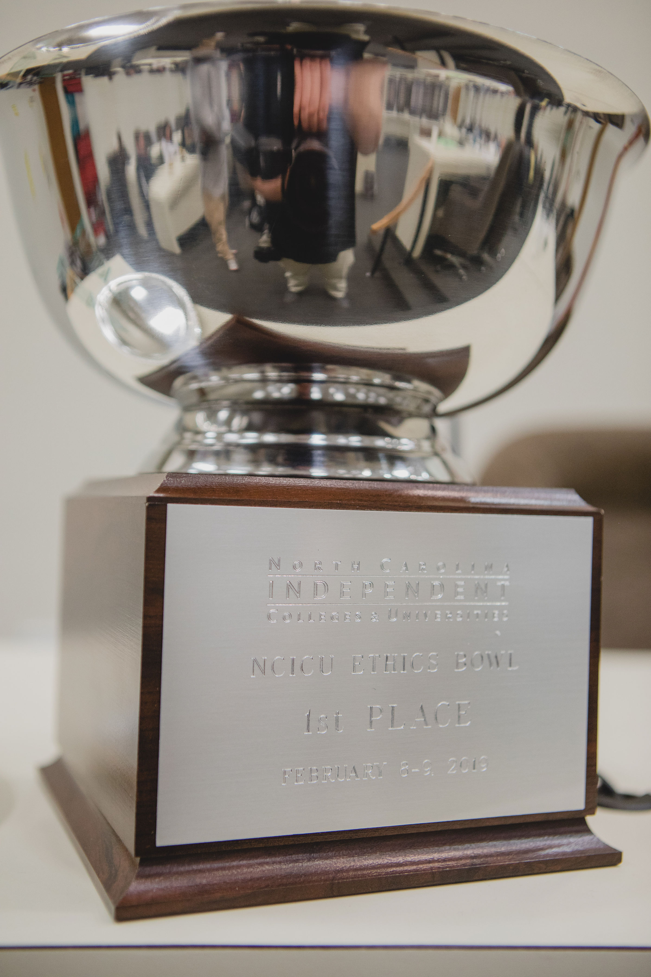

Slide 11
Next years theme:
Ethics in Agriculture

Slide 12
Questions?

