Slide 2
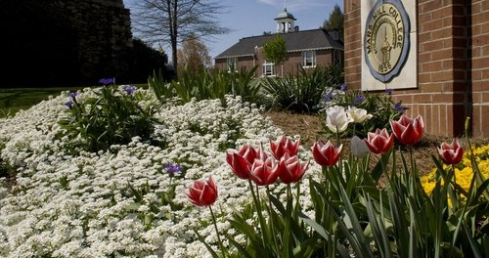
Welcome to Mars Hill University!

Slide 3
Agenda
9 - 9:15 – Breakfast/Snacks
9:15 - 9:45 – Introductions & Icebreaker
9:45 - 10:00 – Welcome from MHU President Tony Floyd
10:00 - 10:15 – Break
10:15 – 11:00 - MHU History, Mission & Vision, myMHU – Self-Service – HR Portal
11:00 – 11:15 - IT Guest Speaker
11:15 – 11:30 – Handbook, Leave Time, etc..
11:30 – 11:45 – Title IV Guest Speaker
11:45 – 12:00 - Packet, Welcome Gifts & Questions
12:00 – Campus Tour
12:30 – Lunch

Slide 4
Introductions

Slide 5
Getting to Know you
Please share three interesting facts about yourself

Slide 6
from
MHU President Tony Floyd

Slide 8
History of Mars Hill University
Who We Are
Mars Hill University is a private, four-year liberal arts institution located in the mountains of Western North Carolina. Founded in 1856 by Baptist families of the region, it is the oldest institution of higher learning in Western North Carolina on its original site.
History of Mars Hill University
In 1856, Mars Hill College was originally founded as the French Broad Baptist Institute of Madison County and later changed to Mars Hill College with the official name change to Mars Hill University in 2013.
Over the years, the University has progressively grown to the established private four-year institution status it now holds. MHU leaders have continued to maintain and guide the institution to keep the course of a Christian based environment while ensuring a productive, thriving, intellectual experience for each student for over 160 years!

Slide 9
Mars Hill University Mission & Vision
Mission Statement
Mars Hill University, an academic community rooted in the Christian faith, challenges and equips students to pursue intellectual, spiritual, and personal growth through an education that is:
Grounded in a rigorous study of the Liberal Arts.
Connected with the world of work.
Committed to character development, to service, and to responsible citizenship in the community, the region, and the world.
Vision Statement
Mars Hill University will be a preeminent private university, nationally recognized for transforming engaged learners into ethical citizens and successful leaders in an ever-changing world.

Slide 10
Navigating Online Resources
Mars Hill University Website
Mymhu & Employee Handbook
Hr portal
Safe colleges training
Self-Service

Slide 11
Important information
University Mission & Vision
Title IX, Wellness Center, Counseling, and Disability Services
Center for Diversity, Equity, and Inclusion
MHU Self-Service
Responsible pto and holidays
Job Description (in packet)

Slide 12
Important information
MHU Religious Statement
Bias Incident Response Information
Student Confidentiality
The Student Experience

Slide 13
RESPONSIBLE PTO Supporting work/life harmony for employees Begins January 2nd, 2024
Includes vacation, personal, and sick time.
Request time off through paychex which will be approved and maintained by your supervisor.
Up to two weeks can be requested at a time due to department coverage.
After one year of employment, if an employee needs to be out for a qualified fmla event (extended illness (self or family member) maternity leave, etc.), mhu will cover your pay and your benefits for up to 12 weeks (consecutive or in increments).

Slide 14
Holidays
New Year’s Day (1 Day)
Martin Luther King Jr. Day (1 Day)
Spring Break (2 Days)
Good Friday (1Day)
Memorial Day (1 Day)
Juneteenth (1DAY)
4th of July (1 Day)
Thanksgiving (3 Days)
Christmas Break (~10 Days)
*JUNE & JULY – EACH FRIDAY ADM OFFICES CLOSE AT 2:00

Slide 16
Campus tour

